Slide 1





RPM
Yum
REDHAT
CentOS
apt
dpkg

Slide 2
RPM
Yum
REDHAT
CentOS
apt
dpkg

Slide 3
Kubernetes Package Manager

Slide 4






Slide 5
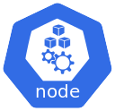


Master
Worker Node
Worker Node
Environment variable

Slide 6
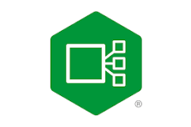






label
label
label
StatefulSet

Slide 7
Helm Chart

Slide 8






Create
Helm Chart
Repository
Uploads
Download
Uses
Install

Slide 9
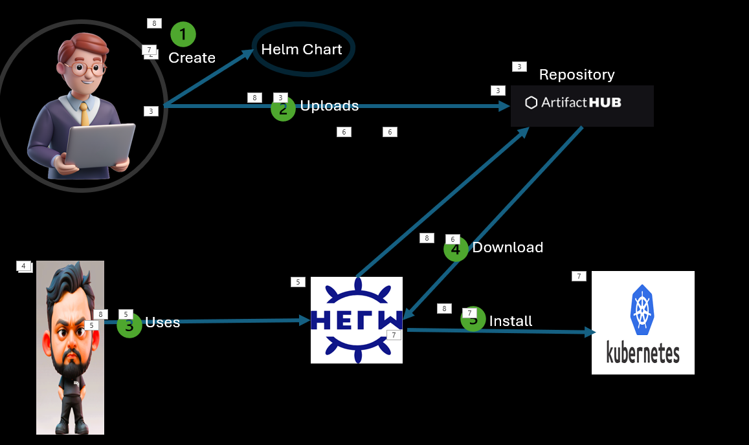
Install Helm command
Need to add the repository (repo)
Search for charts
Install the charts from the repo

Slide 10
How to Install the Helm?
[root@masternode2 ~]# curl -fsSL -o get_helm.sh https://raw.githubusercontent.com/helm/helm/master/scripts/get-helm-3
[root@masternode2 ~]# chmod 700 get_helm.sh
[root@masternode2 ~]# ./get_helm.sh
Downloading https://get.helm.sh/helm-v3.7.1-linux-amd64.tar.gz
Verifying checksum... Done.
Preparing to install helm into /usr/local/bin
helm installed into /usr/local/bin/helm
[root@masternode2 ~]# helm version
version.BuildInfo{Version:"v3.18.0", GitCommit:"cc58e3f5a3aa615c6a86275e6f4444b5fdd3cc4e", GitTreeState:"clean", GoVersion:"go1.24.3"}

Slide 11
How to search the charts?
[root@master1 ~]# helm search hub wordpress --max-col-width=0
URL CHART VERSION APP VERSION DESCRIPTION https://artifacthub.io/packages/helm/kube-wordpress/wordpress 0.1.0 1.1 this is my wordpress package
https://artifacthub.io/packages/helm/wordpress-mariadb/wordpress 1.0.2 1.0.0 A Helm chart for deploying Wordpress+Mariadb stack on kubernet
es.
https://artifacthub.io/packages/helm/bizlinked/wordpress 24.2.6 6.8.1 WordPress is the world's most popular blogging and content man
agement platform. Powerful yet simple, everyone from students to global corporations use it to build beautiful, functional websites.
https://artifacthub.io/packages/helm/bitnami-aks/wordpress 15.2.13 6.1.0 WordPress is the world's most popular blogging and content man
agement platform. Powerful yet simple, everyone from students to global corporations use it to build beautiful, functional websites.
https://artifacthub.io/packages/helm/shubham-wordpress/wordpress 0.1.0 1.16.0 A Helm chart for Kubernetes
https://artifacthub.io/packages/helm/bitnami/wordpress 24.2.6 6.8.1 WordPress is the world's most popular blogging and content man
agement platform. Powerful yet simple, everyone from students to global corporations use it to build beautiful, functional websites.
https://artifacthub.io/packages/helm/devops/wordpress 0.12.0 1.16.0 Wordpress helm chart
https://artifacthub.io/packages/helm/sikalabs/wordpress 0.2.0 Simple Wordpress
https://artifacthub.io/packages/helm/schichtel/wordpress 0.9.2 6.8.1 A Helm chart for WordPress
https://artifacthub.io/packages/helm/sikademo/wordpress 2020.11.18 Example Wordpress Chart (with MySQL)
https://artifacthub.io/packages/helm/skywordpress/wordpress 0.1.0 1.16.0 A Helm chart for WordPress
https://artifacthub.io/packages/helm/camptocamp3/wordpress 0.6.10 4.8.1 Web publishing platform for building blogs and websites.
https://artifacthub.io/packages/helm/riftbit/wordpress 12.1.16 5.8.1 Web publishing platform for building blogs and websites.

Slide 12
[root@master1 ~]# helm repo list
Error: no repositories to show
[root@master1 ~]# helm repo add bitnami https://charts.bitnami.com/bitnami
"bitnami" has been added to your repositories
[root@master1 ~]# helm repo list
NAME URL
bitnami https://charts.bitnami.com/bitnami
[root@master1 ~]# helm search repo wordpress
NAME CHART VERSION APP VERSION DESCRIPTION
bitnami/wordpress 24.2.6 6.8.1 WordPress is the world's most popular blogging ...
bitnami/wordpress-intel 2.1.31 6.1.1 DEPRECATED WordPress for Intel is the most popu...
[root@master1 ~]# kubectl create namespace my-namespace
namespace/my-namespace created
[root@master1 ~]# helm install wordpress1 bitnami/wordpress -n my-namespace --version 24.2.6
NAME: wordpress1
LAST DEPLOYED: Sun May 25 20:51:00 2025
NAMESPACE: my-namespace
STATUS: deployed
REVISION: 1
TEST SUITE: None
NOTES:
CHART NAME: wordpress
CHART VERSION: 24.2.6
APP VERSION: 6.8.1

Slide 13
[root@master1 ~]# helm install wordpress1 bitnami/wordpress -n my-namespace --version 24.2.6
NAME: wordpress1
LAST DEPLOYED: Sun May 25 20:51:00 2025
NAMESPACE: my-namespace
STATUS: deployed
REVISION: 1
TEST SUITE: None
NOTES:
CHART NAME: wordpress
CHART VERSION: 24.2.6
APP VERSION: 6.8.1
[root@master1 ~]# helm install wordpress2 bitnami/wordpress -n my-namespace --version 24.2.6
NAME: wordpress2
LAST DEPLOYED: Sun May 25 21:46:07 2025
NAMESPACE: my-namespace
STATUS: deployed
REVISION: 1
TEST SUITE: None
NOTES:
CHART NAME: wordpress
CHART VERSION: 24.2.6
APP VERSION: 6.8.1

Slide 14
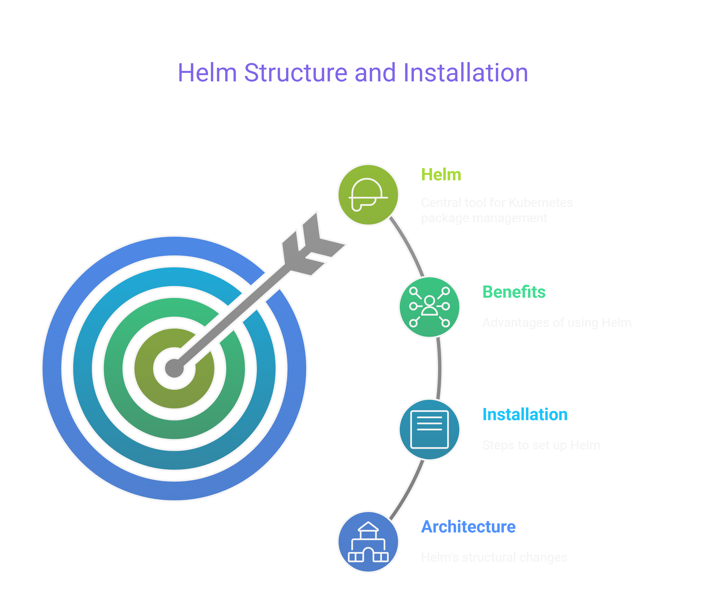

Slide 15
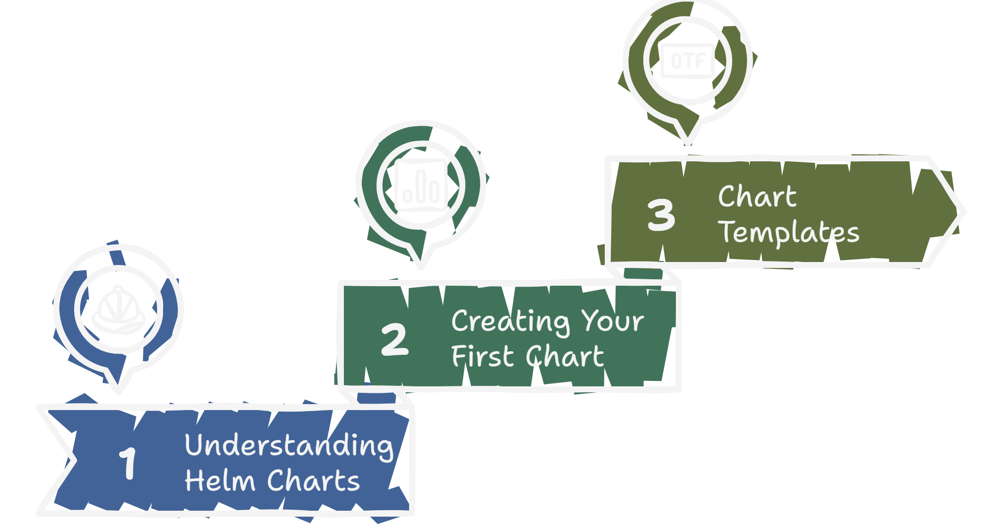

Slide 16


Slide 17
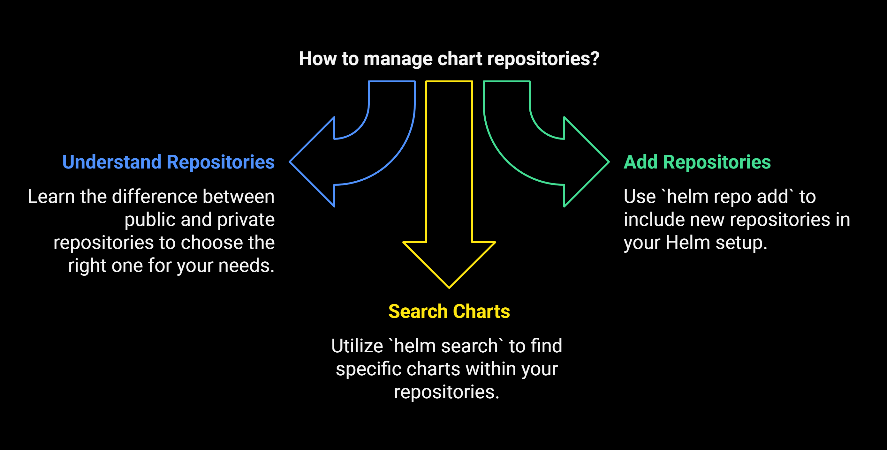

Slide 18
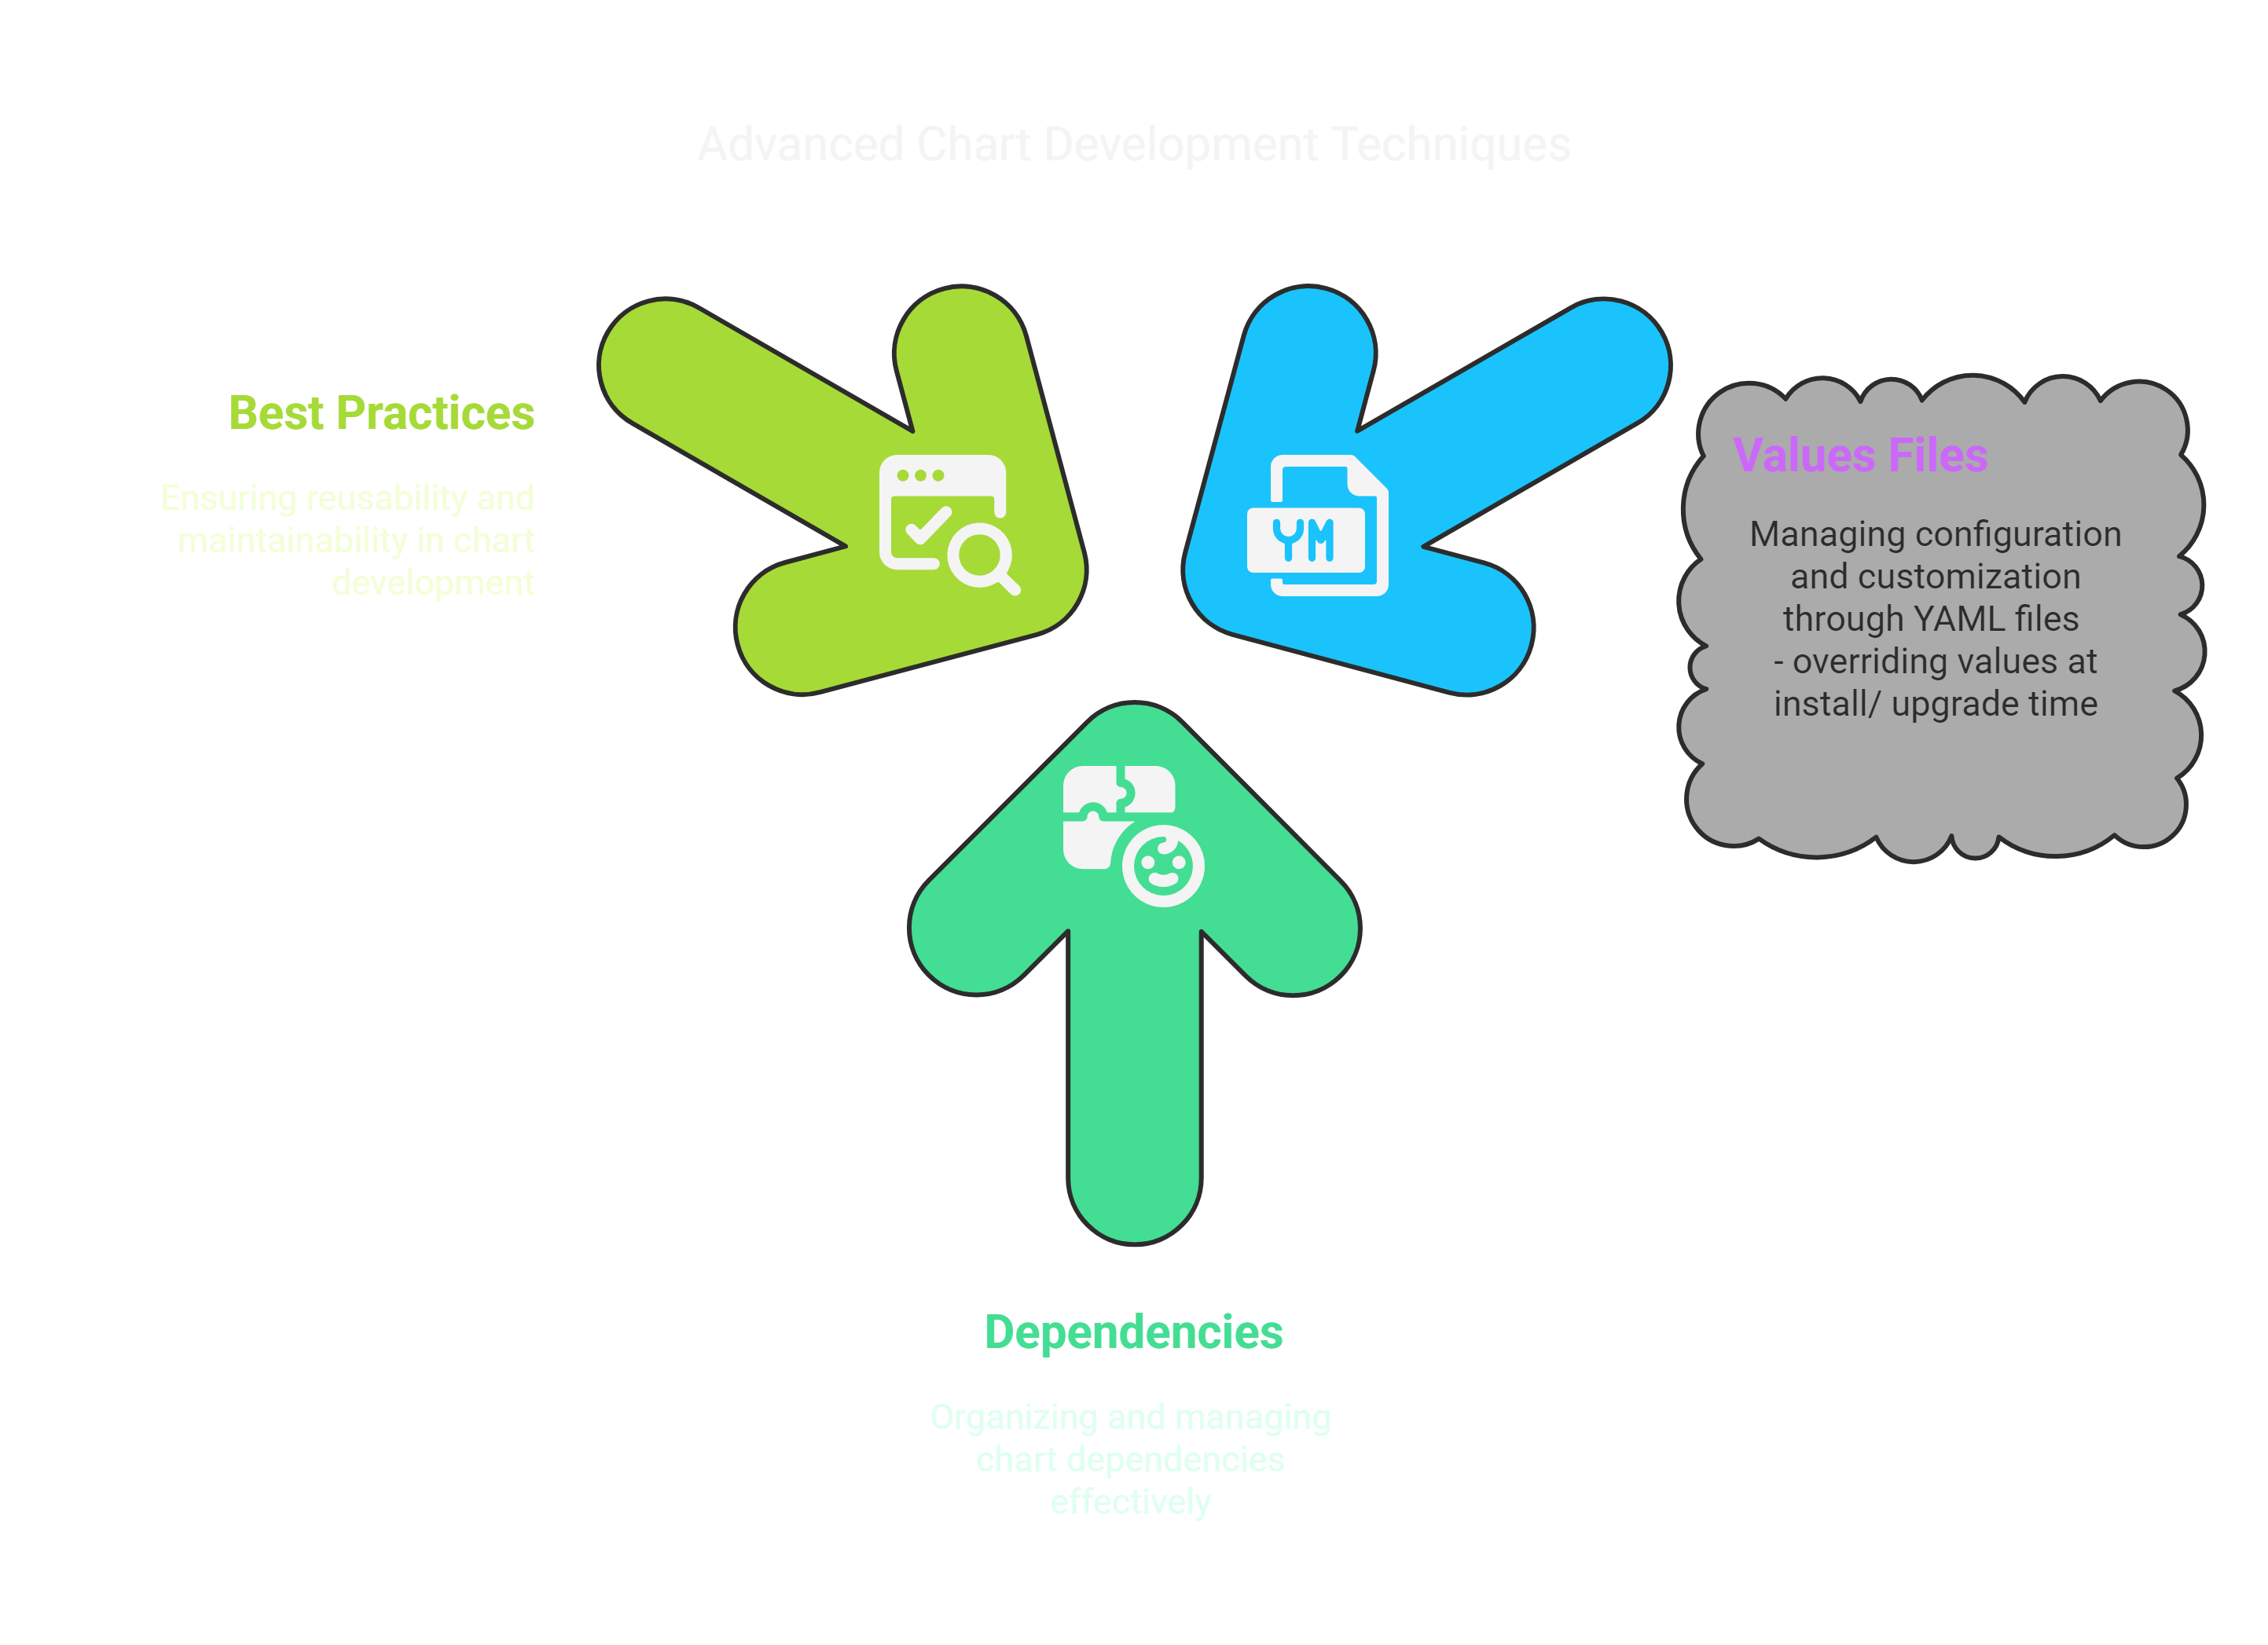

Slide 19
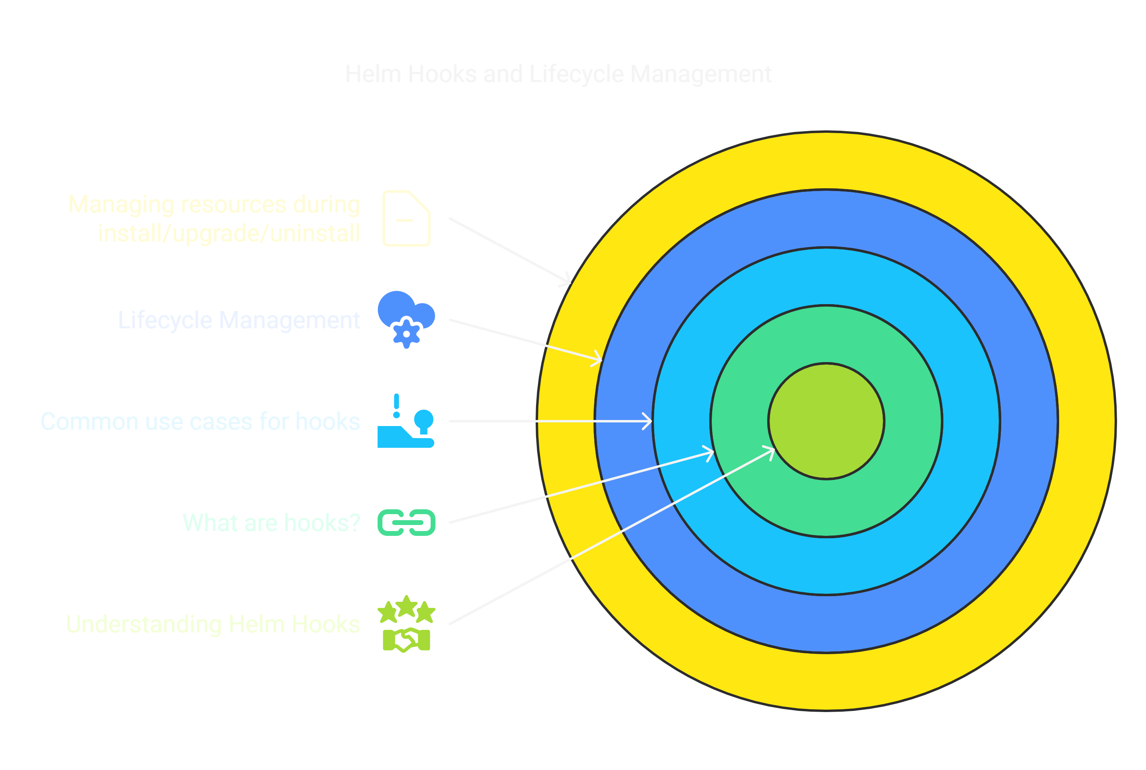

Slide 20
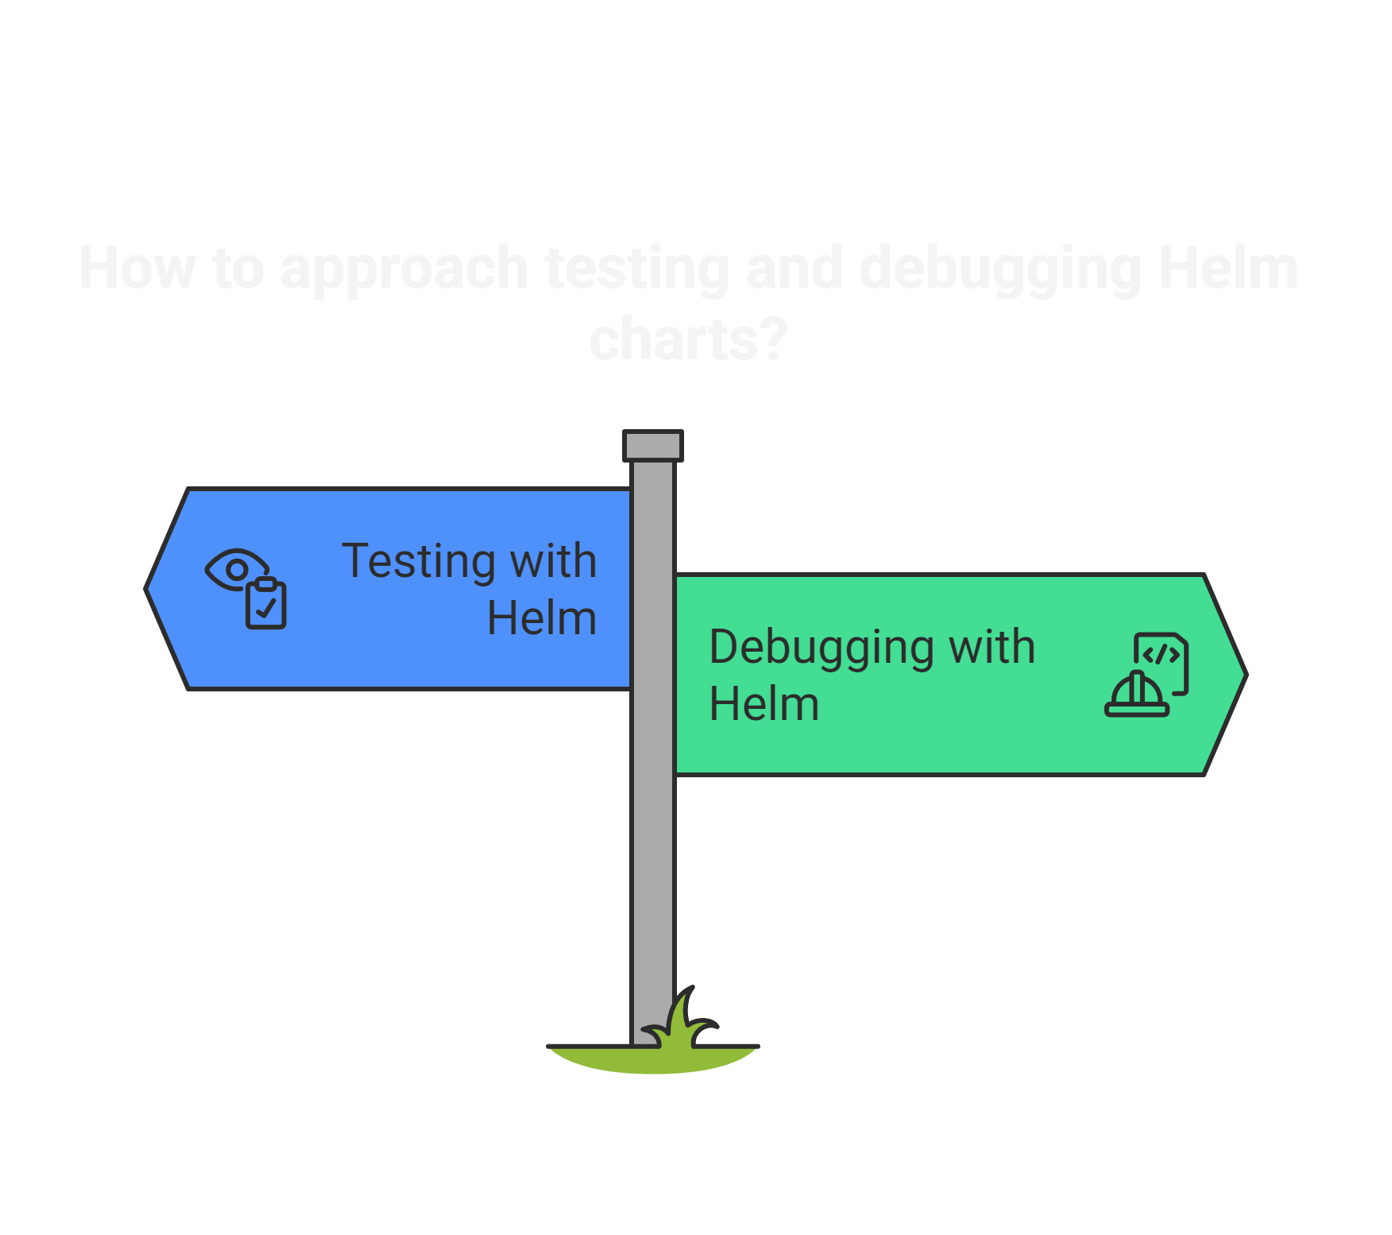

Slide 21
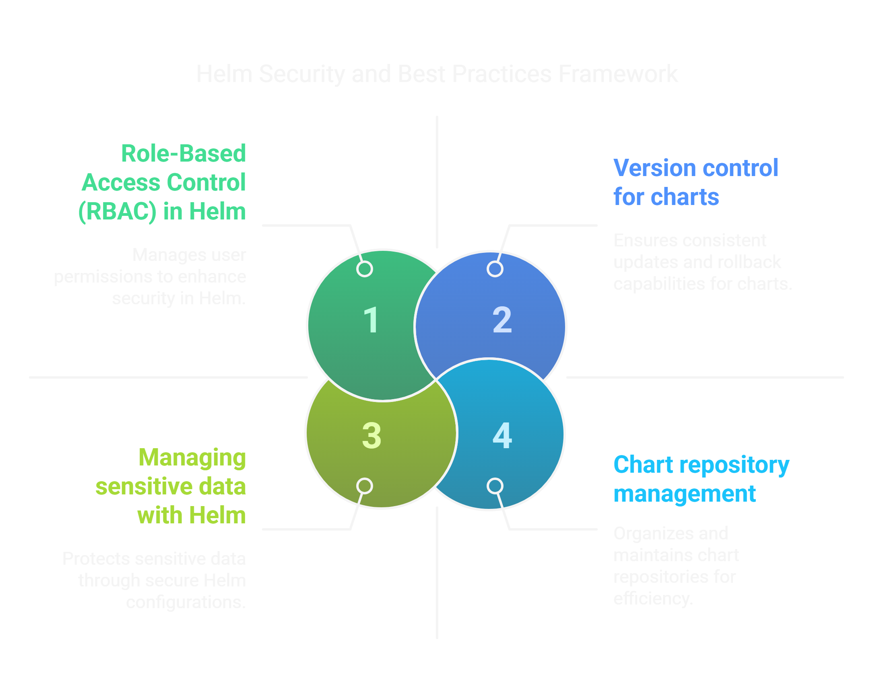

Slide 22
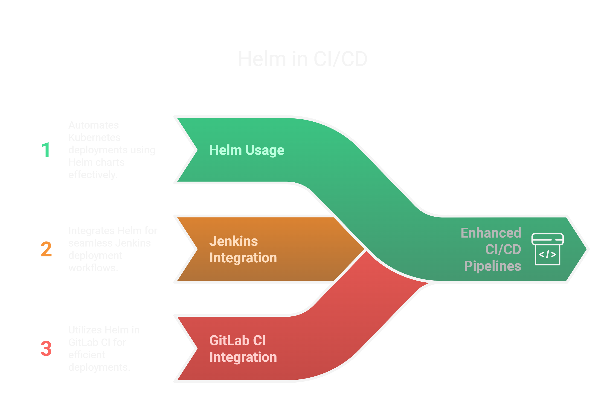

Slide 23
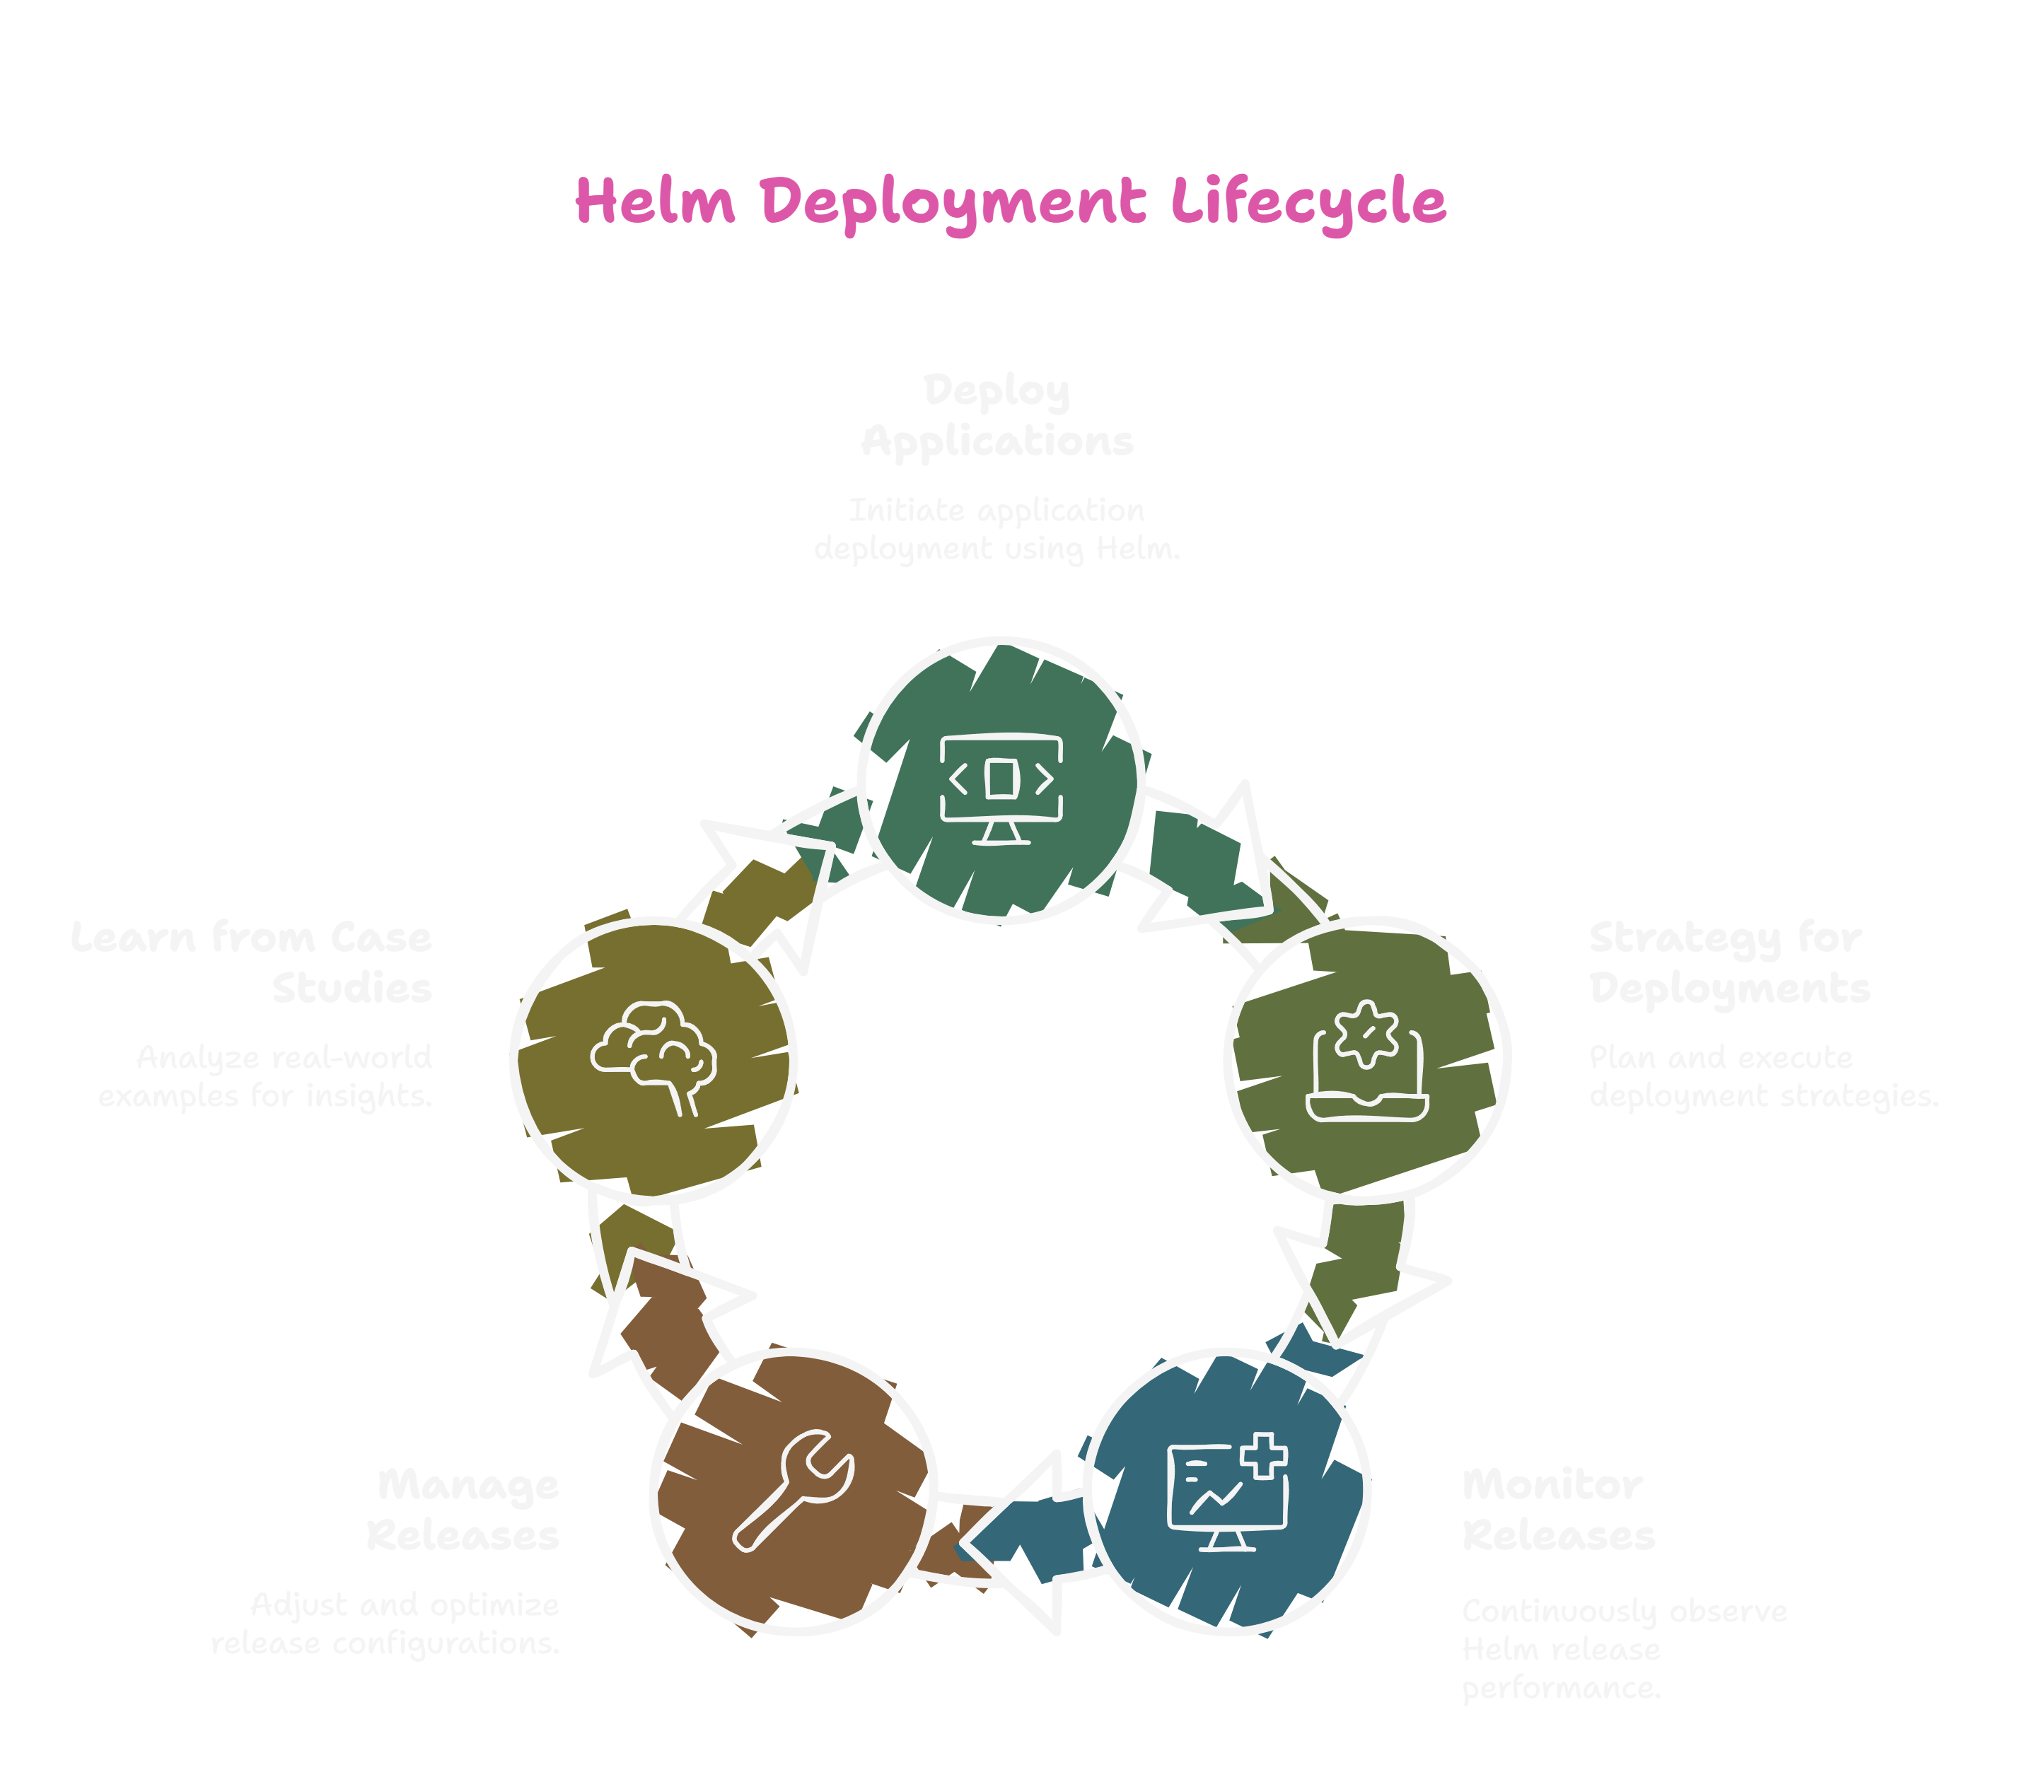

Slide 24
Module 1: Introduction to Helm

Slide 25
Overview of Helm and Its Purpose
What is Helm?
Helm is a package manager for Kubernetes, designed to simplify the deployment and management of applications on Kubernetes clusters. It allows developers and operators to define, install, and upgrade even the most complex Kubernetes applications using a simple and consistent interface.
Key Components of Helm
Charts:
A Helm chart is a collection of files that describe a related set of Kubernetes resources. Charts can define everything from simple applications to complex microservices architectures.
Each chart contains templates, configuration files, and metadata that help in deploying the application.
Repositories:
Helm charts are stored in repositories, which can be public or private. Users can add repositories to their Helm client to access and install charts.
Releases:
When a chart is installed, it creates a release. A release is a specific instance of a chart running in a Kubernetes cluster, allowing for versioning and management of deployments.

Slide 26
Purpose of Helm
Simplified Deployment:
Helm streamlines the deployment process by packaging all necessary Kubernetes resources into a single chart. This reduces the complexity of managing multiple YAML files.
Version Control:
Helm allows users to manage different versions of applications easily. Users can upgrade or roll back releases, making it simple to revert to a previous state if needed.
Configuration Management:
Helm supports templating, enabling users to customize deployments through values files. This allows for easy configuration changes without modifying the underlying chart structure.
Dependency Management:
Helm can manage dependencies between charts, allowing users to define and install related charts together. This is particularly useful for microservices architectures.
Consistency Across Environments:
Helm promotes consistency in deployments across different environments (development, staging, production) by using the same charts with different configuration values.

Slide 27
6. Community and Ecosystem:
Helm has a large and active community, providing a wealth of pre-built charts for popular applications. This accelerates the deployment process and encourages best practices.
7. Integration with CI/CD:
Helm can be easily integrated into Continuous Integration and Continuous Deployment (CI/CD) pipelines, facilitating automated deployments and updates.
Conclusion
Helm serves as a powerful tool for managing Kubernetes applications, providing a structured and efficient way to deploy, upgrade, and maintain applications in a Kubernetes environment. Its ability to simplify complex deployments, manage configurations, and integrate with existing workflows makes it an essential component for developers and operators working with Kubernetes.

Slide 29


You must not create, modify, delete any network policy while working on this task.
ckad-netpol
Web
db
run: web
run: db
Ingress
Egress
Egress
ckad-netpol-newpod
env: newpod

Slide 30
[root@master1 ~]# kubectl -n ckad-netpol get netpol
NAME POD-SELECTOR AGE
allow-all env=newpod 64m
db-netpol app=db 68m
default-deny-all <none> 176m
web-netpol app=web 68m
[root@master1 ~]# kubectl -n ckad-netpol describe netpol allow-all
Name: allow-all
Namespace: ckad-netpol
Created on: 2025-03-17 22:23:58 +0530 IST
Labels: <none>
Annotations: <none>
Spec:
PodSelector: env=newpod
Allowing ingress traffic:
To Port: <any> (traffic allowed to all ports)
From:
PodSelector: app=newpod
Allowing egress traffic:
To Port: <any> (traffic allowed to all ports)
To:
PodSelector: app=newpod
Policy Types: Ingress, Egress
NetPol apply to pod which has label env: newpod

Slide 31
You must not create, modify, delete any network policy while working on this task.
[root@master1 ~]# kubectl -n ckad-netpol get pods --show-labels -o wide
NAME READY STATUS RESTARTS AGE IP NODE NOMINATED NODE READINESS GATES LABELS
ckad-netpol-newpod 1/1 Running 0 11s 172.16.14.109 workernode2.example.com <none> <none> env=newpod
db 1/1 Running 0 11s 172.16.14.108 workernode2.example.com <none> <none> run=db
web 1/1 Running 0 12s 172.16.14.107 workernode2.example.com <none> <none> run=web
kubectl -n ckad-netpol exec -it ckad-netpol-newpod -- curl 172.16.14.108 --connect-timeout 3
curl: (28) Failed to connect to 172.16.14.108 port 80 after 3001 ms: Timeout was reached
command terminated with exit code 28
kubectl -n ckad-netpol exec -it ckad-netpol-newpod -- curl 172.16.14.107 --connect-timeout 3
[root@master1 ~]# kubectl -n ckad-netpol describe netpol allow-all
Name: allow-all
Namespace: ckad-netpol
Created on: 2025-03-17 22:23:58 +0530 IST
Labels: <none>
Annotations: <none>
Spec:
PodSelector: env=newpod
Allowing ingress traffic:
To Port: <any> (traffic allowed to all ports)
From:
PodSelector: env=newpod
Allowing egress traffic:
To Port: <any> (traffic allowed to all ports)
To:
PodSelector: env=newpod
Policy Types: Ingress, Egress
curl: (28) Failed to connect to 172.16.14.107 port 80 after 3000 ms: Timeout was reached
command terminated with exit code 28
[root@master1 ~]# kubectl -n ckad-netpol label pods db env=newpod
pod/db labeled
[root@master1 ~]# kubectl -n ckad-netpol label pods web env=newpod
pod/web labeled

Slide 32
[root@master1 ~]# kubectl -n ckad-netpol get pods --show-labels -o wide
NAME READY STATUS RESTARTS AGE IP NODE NOMINATED NODE READINESS GATES LABELS
ckad-netpol-newpod 1/1 Running 0 11s 172.16.14.109 workernode2.example.com <none> <none> env=newpod
db 1/1 Running 0 11s 172.16.14.108 workernode2.example.com <none> <none> env=newpod,run=db
web 1/1 Running 0 12s 172.16.14.107 workernode2.example.com <none> <none> env=newpod,run=web
[root@master1 ~]# kubectl -n ckad-netpol exec -it ckad-netpol-newpod -- curl 172.16.14.108 --connect-timeout 3
<!DOCTYPE html>
<html>
<head>
<title>Welcome to nginx!</title>
<style>
html { color-scheme: light dark; }
body { width: 35em; margin: 0 auto;
font-family: Tahoma, Verdana, Arial, sans-serif; }
</style>
</head>
<body>
<h1>Welcome to nginx!</h1>
<p>If you see this page, the nginx web server is successfully installed and
working. Further configuration is required.</p>
<p>For online documentation and support please refer to
<a href="http://nginx.org/">nginx.org</a>.<br/>
Commercial support is available at
<a href="http://nginx.com/">nginx.com</a>.</p>
<p><em>Thank you for using nginx.</em></p>
</body>
</html>

Slide 33
[root@master1 ~]# kubectl -n ckad-netpol get pods --show-labels -o wide
NAME READY STATUS RESTARTS AGE IP NODE NOMINATED NODE READINESS GATES LABELS
ckad-netpol-newpod 1/1 Running 0 11s 172.16.14.109 workernode2.example.com <none> <none> env=newpod
db 1/1 Running 0 11s 172.16.14.108 workernode2.example.com <none> <none> env=newpod,run=db
web 1/1 Running 0 12s 172.16.14.107 workernode2.example.com <none> <none> env=newpod,run=web
[root@master1 ~]# kubectl -n ckad-netpol exec -it ckad-netpol-newpod -- curl 172.16.14.107 --connect-timeout 3
<!DOCTYPE html>
<html>
<head>
<title>Welcome to nginx!</title>
<style>
html { color-scheme: light dark; }
body { width: 35em; margin: 0 auto;
font-family: Tahoma, Verdana, Arial, sans-serif; }
</style>
</head>
<body>
<h1>Welcome to nginx!</h1>
<p>If you see this page, the nginx web server is successfully installed and
working. Further configuration is required.</p>
<p>For online documentation and support please refer to
<a href="http://nginx.org/">nginx.org</a>.<br/>
Commercial support is available at
<a href="http://nginx.com/">nginx.com</a>.</p>
<p><em>Thank you for using nginx.</em></p>
</body>
</html>
[root@master1 ~]#
[root@master1 ~]# kubectl -n ckad-netpol label pods web env-

